Slide 1

INFOSYS SPRINGBOARD 5.0 PROJECT
Project Name :- Inventory
Management

Slide 2

INTERNS INVOLVED IN THE PROJECT
Pratik Kumar Singh
Vaibhavi Kharawane
Deepak Mandarapu
Sravanthi Kalyanam
Sai Ram Nyalata

Slide 3
INTRODUCTION TO INVENTORY MANAGEMENT
“Seamless inventory, smarter business.”
StockSync - Inventory Management System is a comprehensive MERN stack-based solution designed to streamline inventory tracking, supplier management, order processing, and sales monitoring for businesses. It enables seamless stock management by reducing manual errors and improving operational efficiency. The system supports real-time stock updates, user authentication with role-based access, and automated order tracking, ensuring smooth and secure business operations. Admins have access to all functionalities, while regular users can interact with essential features like the shop page. The platform also offers intelligent alerts for low-stock levels and order status changes, along with a robust dashboard that delivers detailed insights into sales, purchases, and inventory performance. By integrating modern web technologies, StockSync simplifies inventory workflows, enhances supply chain transparency, and ultimately drives higher productivity and better decision-making for businesses of all sizes.

Slide 4
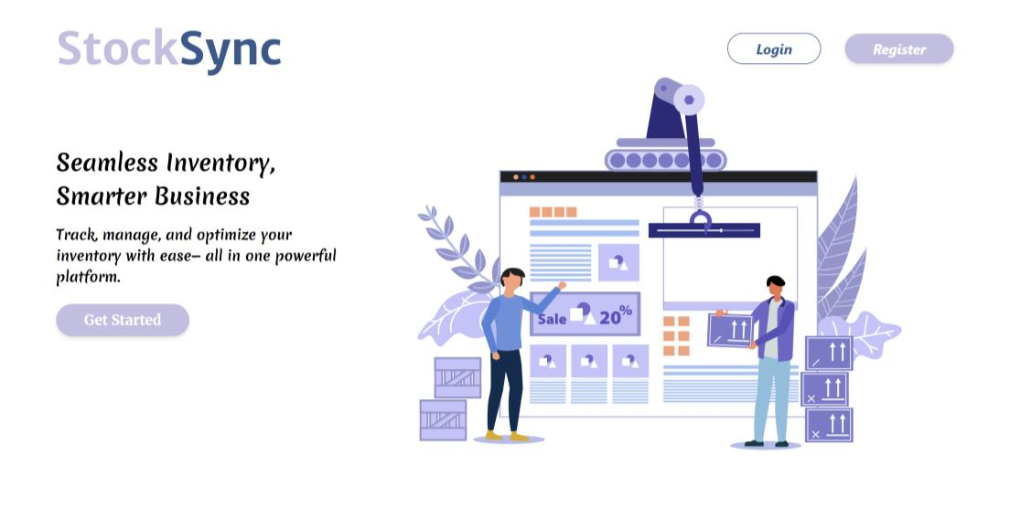
LANDING PAGE
The landing page serves as the entry point to the application, offering essential navigation options such as Login, Register, and Get Started
Register: Takes the user to Register page to create a new account.
Login: Takes the user to login page to access their existing account.
Get Started: Start out great app.

Slide 5
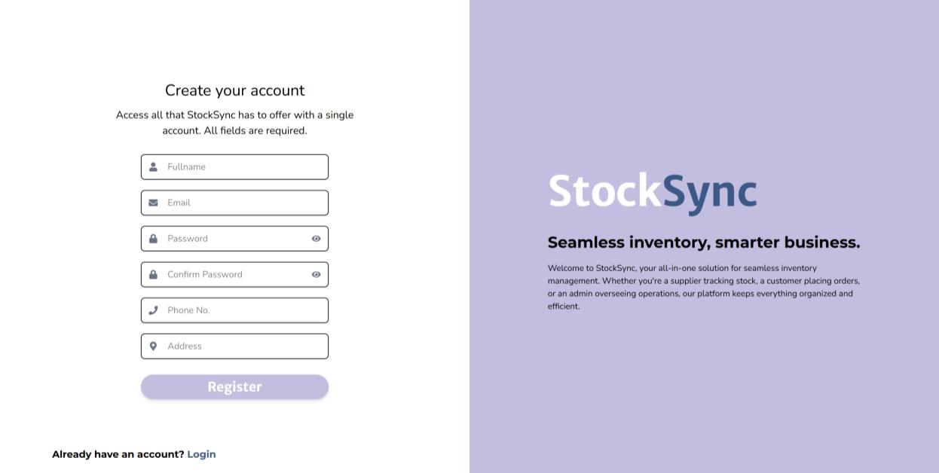
REGISTATION PAGE
• Multiple Field Collection: Gathers fullname, email, password, phone number, and address.
• Password Strength Verification: Ensures users create secure passwords with confirmation field.
• Field Validation: Validates all input fields to ensure proper formatting and completeness.
• Account Linking: Provides option to navigate to login for users who already have accounts.

Slide 6
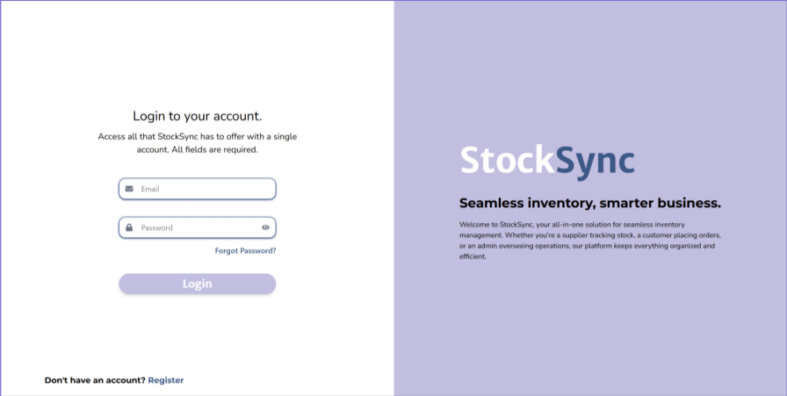
LOGIN PAGE
Users can log in with email and password.
A Forgot password option is available for account recovery.
New users can create an account easily by clicking on the Register Button.
The page ensures a smooth and secure login experience.

Slide 7
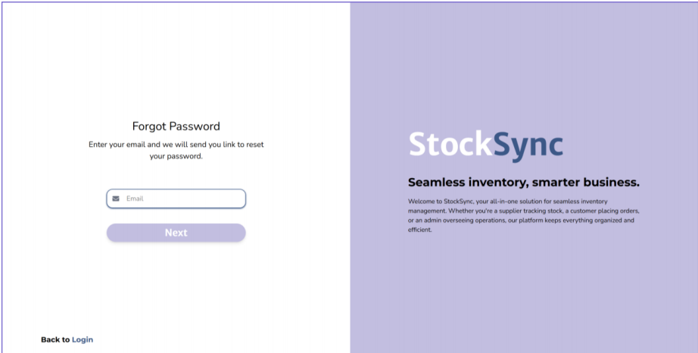
Forgot Password Page
• Email Submission: Collects user's registered email address for verification.
• Recovery Link Generation: Triggers system to send password reset instructions to user's email.
• User Guidance: Provides clear instructions on the password recovery process.
• Navigation Options: Includes link to return to the login page if recovery is not needed.

Slide 8
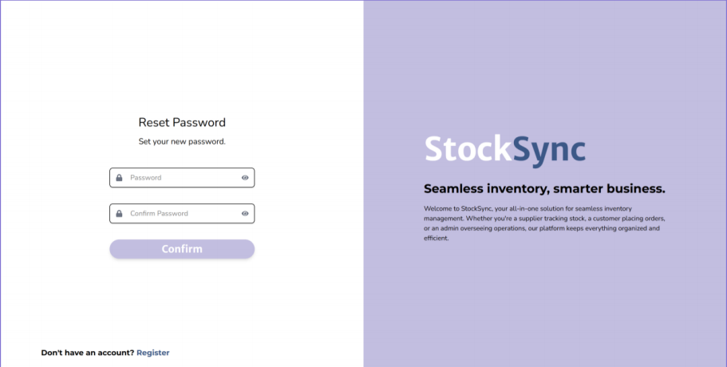
Reset Password Page
• New Password Creation: Provides fields for entering and confirming new password.
• Security Validation: Ensures token authenticity before allowing password changes.
• Password Requirements: Enforces password strength and matching confirmation.
• Completion Handling: Processes the password change and redirects users appropriately

Slide 9
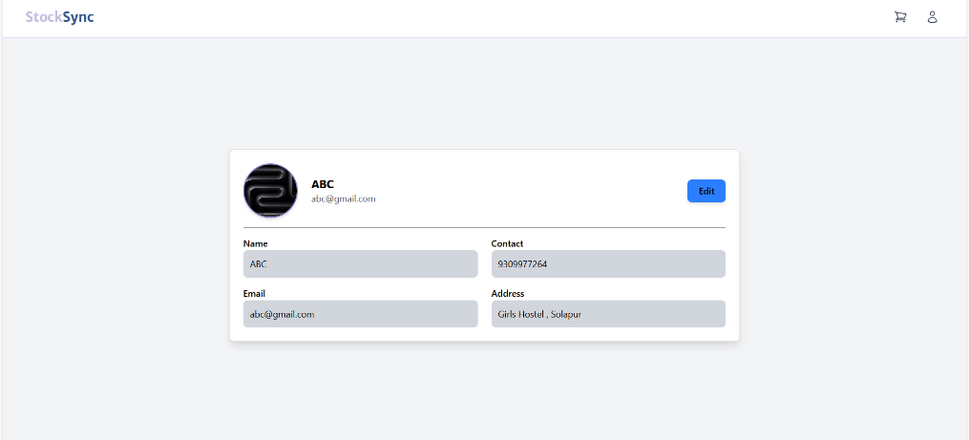
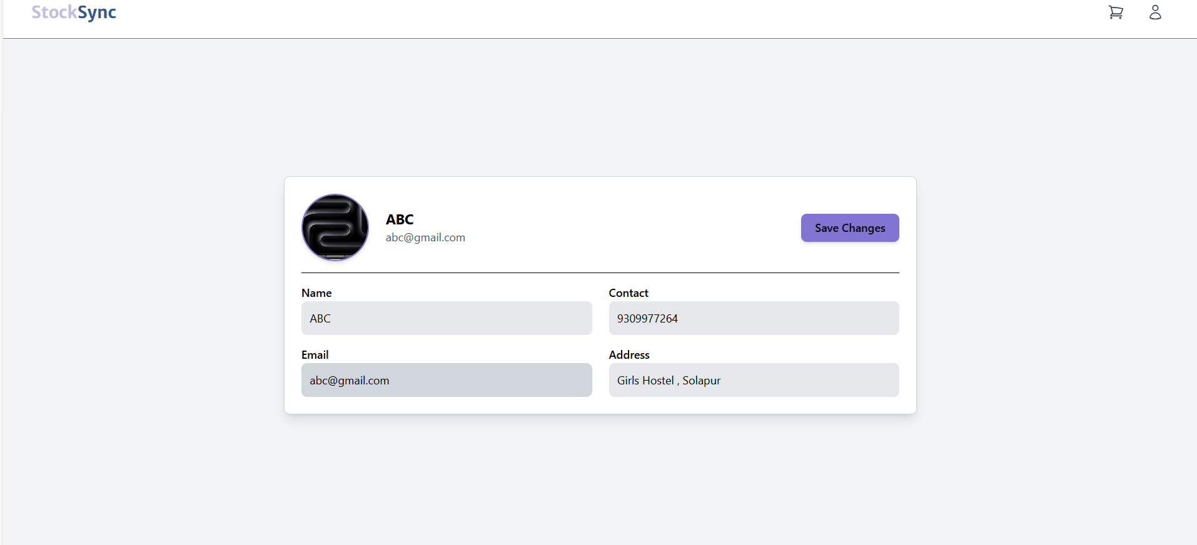
Profile Page
• User Information Display: Shows name, email, contact, and address in a structured format.
• Edit Mode: Users can update their details by clicking the "Edit" button.
• Save Changes: After modifications, users can save their updates using the "Save Changes" button.
• User Avatar: Displays a profile picture for easy identification.

Slide 10
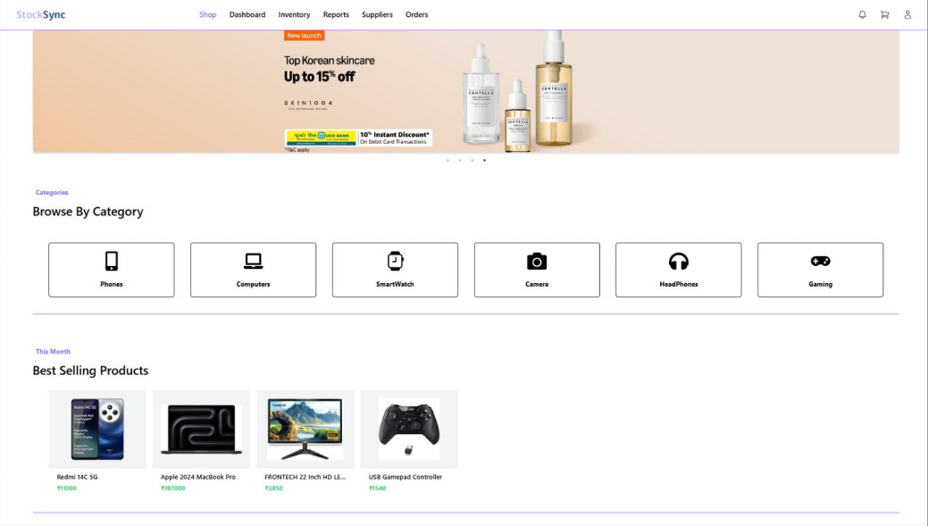
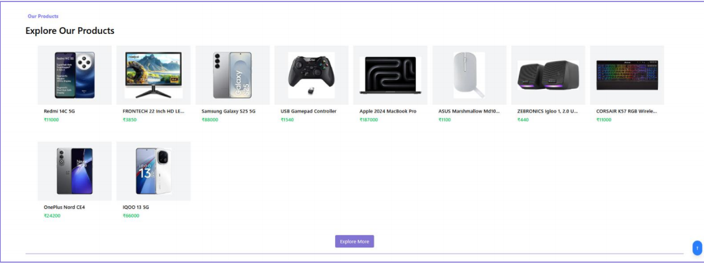
SHOP PAGE
Product Overview – High-quality image, brief description, and key specifications.
Features & Pricing – Detailed specs, price, offers, and availability.
User Reviews & Call to Action – Customer rating, top reviews, and “Buy Now” link

Slide 11
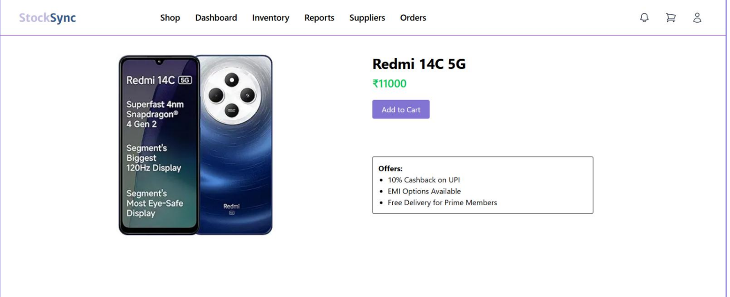
Product Page
• Product Info: Shows product name, price, and image.
• Add to Cart: Button to quickly add the item to the cart.
• Offers Section: Lists special deals like cashback, EMI options, and free delivery.
• Clean Layout: Simple design for easy navigation and readability.

Slide 12
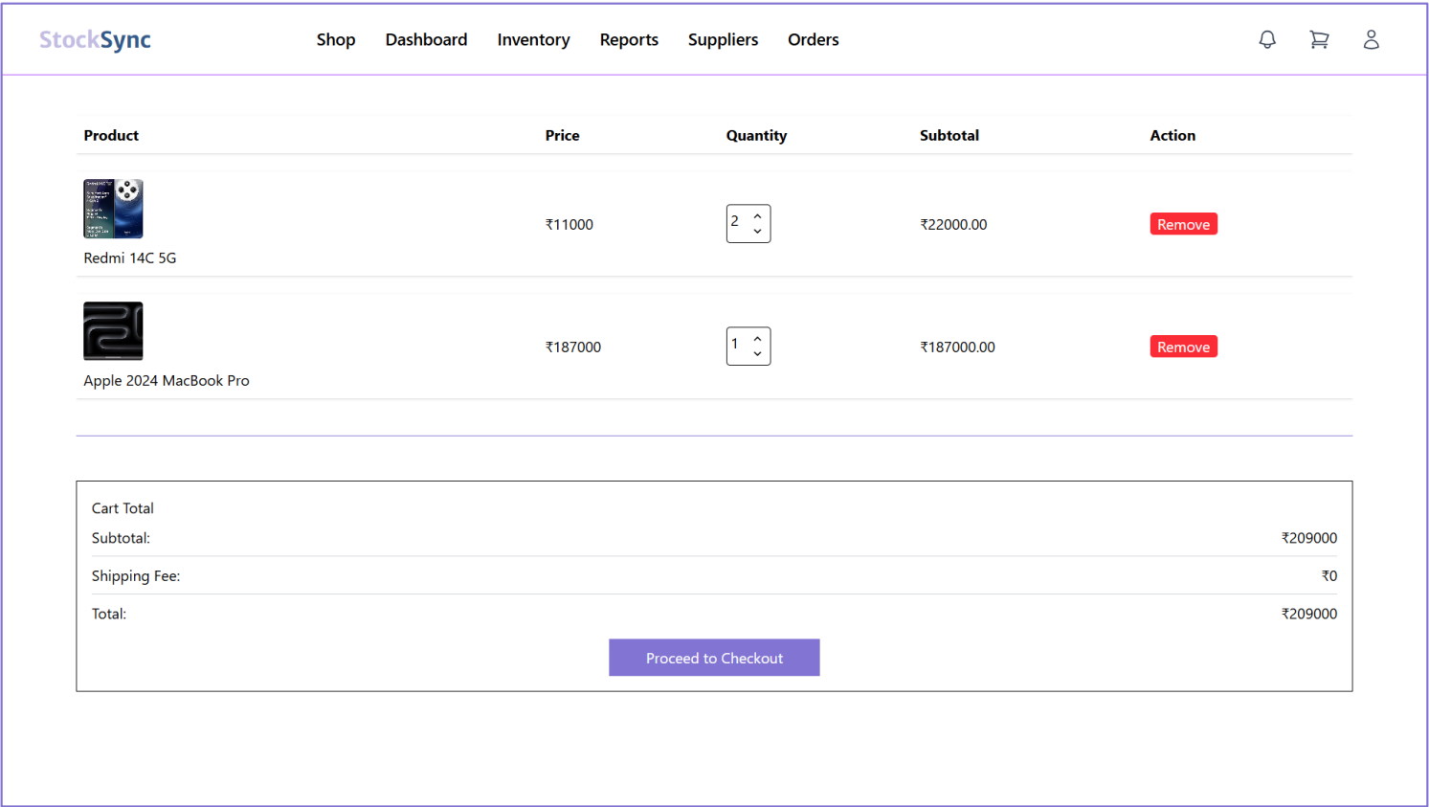
Cart Page
• Product List: Shows product image, name, price, quantity selector, and subtotal.
• Remove Option: Allows users to delete items from the cart with a single click.
• Price Summary: Clearly lists subtotal, shipping fee, and total cost.
• Checkout Button: Directs users to the payment and order confirmation page.
• Clean UI: Organized layout for a smooth and user-friendly experience.

Slide 13
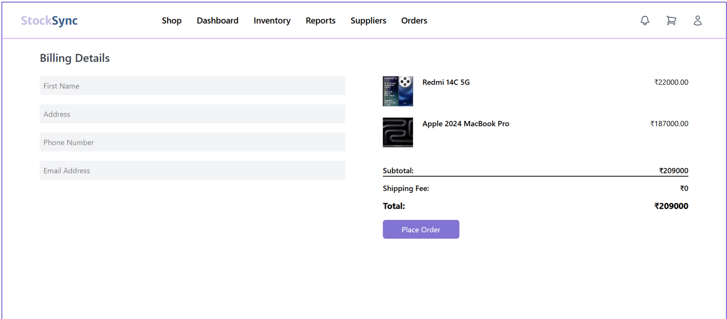
Checkout Page
• Billing Form: Collects customer information – name, address, phone number, and email.
• Order Summary: Lists selected products with names, prices, and total cost.
• Cost Breakdown: Displays subtotal, shipping fee, and grand total.
• Place Order Button: Finalizes the purchase and submits the order.
• Minimal & Clean Design: Ensures user-friendly experience during checkout.

Slide 14
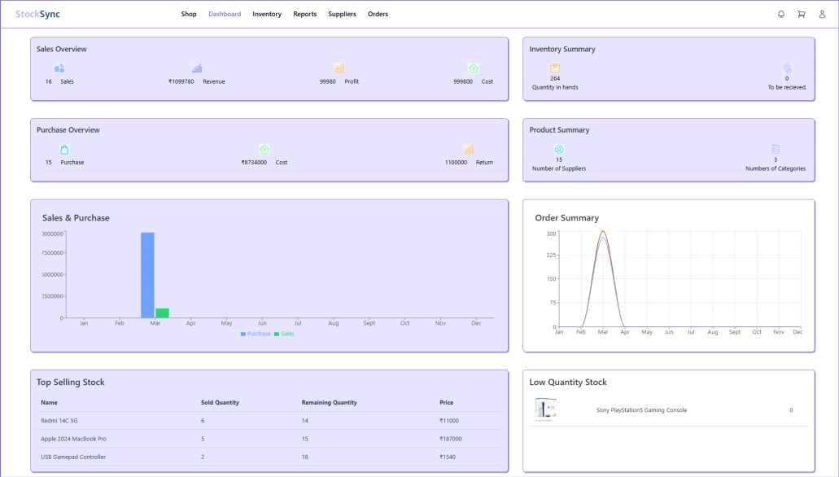
DASHBOARD
Sales & Purchase Overview – Dashboard total sales, revenue, profit, and purchase cost.
Inventory Summary – Shows stock availability, quality in hard, and pending orders.
Product & Supplier Summary – Tracks number of suppliers and product categories.
Performance insights – visual reports on top-selling and low-stock products.

Slide 15
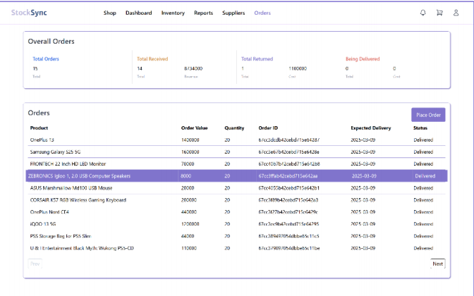
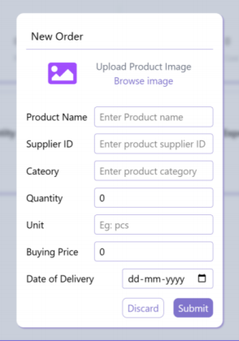
ORDER PAGE
Order Overview – Display total orders, received, returned, and pending deliveries.
Order List – Show product details, order value, quantity, order ID, expected delivery, and status.
New Order Form – Allow users to add a new order with product name, supplier ID, category, quantity, unit, price, and delivery date.

Slide 16
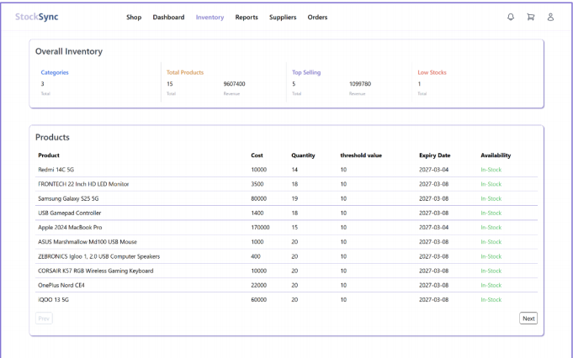
INNVENTORY PAGE
Inventory Overview – Track total products, top-selling items, and low-stock alerts.
Product Details – Monitor cost, quantity, threshold value, expiry date, and availability.
Stock Management – Ensures real-time stock updates for efficient inventory control.
Optimized Workflow – Helps prevent stockouts and overstocking issues.

Slide 17
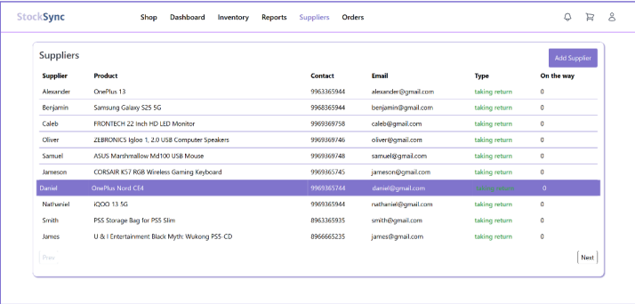
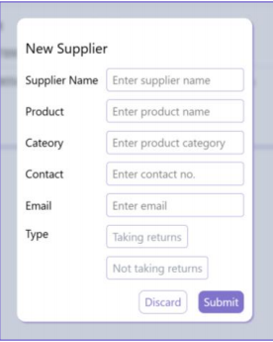
SUPPLIERS DETAILS
Supplier Management – Add, edit, and track supplier details in one place.
Key information – Store supplier, name, product, contact, email, and return policy.
Efficiency – Streamlined supplier coordination for smooth inventory flow.
Easy Access – Quick supplier addition and real- time updates for better management.

Slide 18
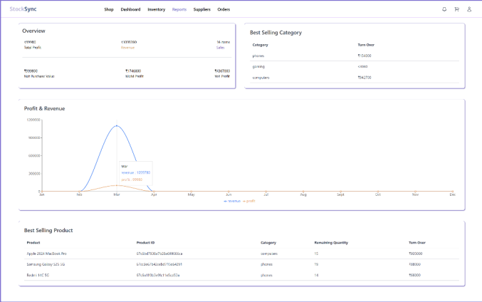
REPORT PAGE
• Overview Dashboard – Displays key metrics like Total Profit, Revenue, Net Purchase Value, MoM and
YoY Profit, and Total Sales Items.
• Best Selling Category – Highlights top-performing categories based on turnover.
• Profit & Revenue Chart – Visual representation of monthly revenue and profit trends.
• Best Selling Products – Lists top-selling products with details like Product ID, Category, Remaining
Quantity, and Turnover.

Slide 19
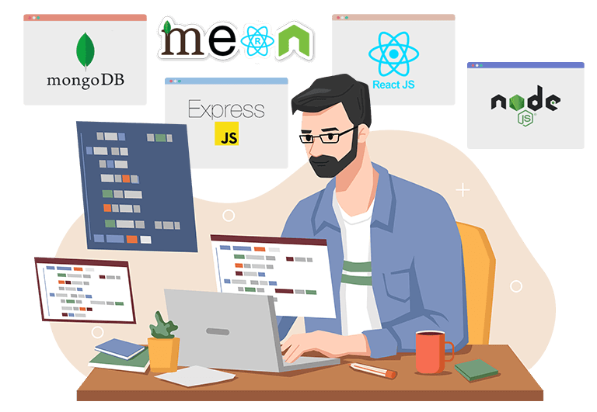
TECHNOLOGY STACK
MongoDB: Mongo stores and manages expense data efficiently with real-time update
Express.js: Express.js handles backend logic, API routes, and server-side processing efficiently.
React.js: React.js provides a dynamic and responsive user interface for seamless expense management.
Node.js: Node.js powers the backend, handling server-side operations and API requests efficiently.

Slide 20

FUTURE IMPLEMENTION
• Predictive Inventory Management: Implement
machine learning algorithms to forecast inventory
needs based on historical data and seasonal trends.
• Native Mobile Applications: Develop dedicated iOS and Android apps for on-the-go inventory
management.
• Barcode/QR Scanner Integration: Allow for mobile scanning of products for quick stock checks and
updates
• Automated Purchase Orders: Generate and send purchase orders automatically when stock
reaches threshold levels.
• Personalized Product Recommendations: Suggest products based on customer purchase history.
• Onboarding Wizard: Create interactive tutorials for new users

Slide 21

CONCLUSION
StockSync is a robust MERN stack-based inventory management system designed to streamline stock tracking, order processing, and business operations. By automating key tasks, it enhances efficiency, reduces errors, and improves decision-making for both users and administrators.
With future enhancements like AI-driven analytics, mobile integration, and advanced security measures, StockSync aims to become a more intelligent and scalable solution. Its continuous evolution will ensure better inventory control, seamless operations, and greater business growth.

Slide 22
THANK YOU

